Slide 1

SOLAR POWER GENERATION MONITORING AND FAULT DETECTION USING IoT
KNOWLEDGE INSTITUTE OF TECHNOLOGY

Slide 2
SOLAR POWER GENERATION MONITORING AND FAULT DETECTION USING IoT
KNOWLEDGE INSTITUTE OF TECHNOLOGY
Smart Solar Power Monitoring System
Real-time monitoring of solar panel performance.
Voltage and current measurement for power generation analysis.
Automatic fault detection during abnormal operating conditions.
IoT-based remote monitoring through a connected dashboard.
Instant alerts to improve solar system reliability and maintenance.

Slide 3
Double Content Slide
KNOWLEDGE INSTITUTE OF TECHNOLOGY
Technical Architecture
The system uses an ESP32 microcontroller connected to voltage, current, temperature, and light sensors to monitor solar panel performance. The generated power is calculated using voltage and current measurements. If the measured values exceed predefined limits, the LED and buzzer are activated to indicate a fault. Sensor data is transmitted through Wi-Fi to an IoT dashboard for real-time monitoring.
User Value & Impact
This system improves solar energy monitoring by providing automatic fault detection and real-time data. It helps identify abnormal conditions quickly, reduces manual inspection, and improves the efficiency and reliability of solar power systems.

Slide 4
Bulleted List Slide
KNOWLEDGE INSTITUTE OF TECHNOLOGY
• ESP32 Microcontroller – Main controller
• Solar Panel – Solar energy generation
• INA219 Sensor – Voltage and current measurement
• DHT22 Sensor – Temperature monitoring
• LDR Sensor – Sunlight intensity measurement
• 12V Battery – Energy storage
• LED & Buzzer – Fault indication
• Wi-Fi Connectivity – Real-time IoT communication
• Blynk IoT Dashboard – Remote monitoring
• Automatic Fault Detection – Identifies abnormal conditions

Slide 5
Comparison Slide
KNOWLEDGE INSTITUTE OF TECHNOLOGY
Compare Section
Contrast Section
Similar to existing solar monitoring systems, this project focuses on monitoring solar panel performance by measuring voltage, current, power, and temperature. It helps users understand the operating condition of the solar power system.
Unlike traditional solar systems that require manual checking, this system provides real-time IoT-based monitoring and automatic fault alerts. It continuously checks the solar parameters and activates LED and buzzer warnings when abnormal conditions are detected.

Slide 6
Prototype
KNOWLEDGE INSTITUTE OF TECHNOLOGY
Prototype built using ESP32 as the main controller with INA219 sensor for solar voltage and current monitoring.
DHT22 sensor is used to monitor temperature, while an LDR is used to measure sunlight intensity.
LED and buzzer provide alerts when abnormal solar conditions or faults are detected.
Compact and portable setup powered through USB for easy demonstration.

Slide 7
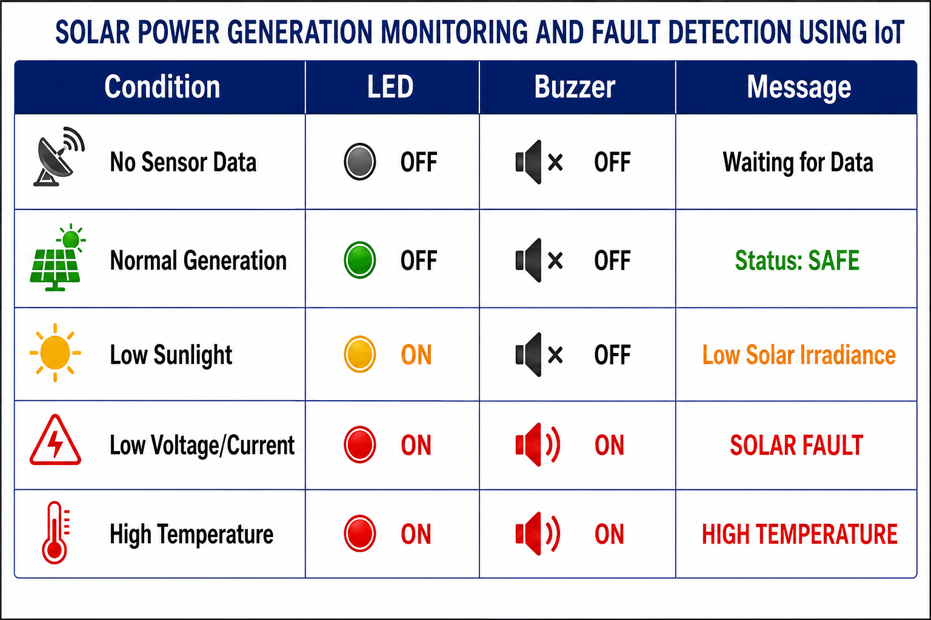
Detection Breakdown
KNOWLEDGE INSTITUTE OF TECHNOLOGY

Slide 8
CONCLUSION
KNOWLEDGE INSTITUTE OF TECHNOLOGY
The Solar Power Generation Monitoring and Fault Detection Using IoT system continuously monitors solar panel voltage, current, power generation, temperature, and sunlight intensity.
When abnormal conditions are detected, the system provides automatic LED and buzzer alerts and updates the IoT dashboard.
It is a low-cost and effective solution that helps improve solar power system reliability, reduce manual monitoring, and support efficient maintenance.

